Slide 1

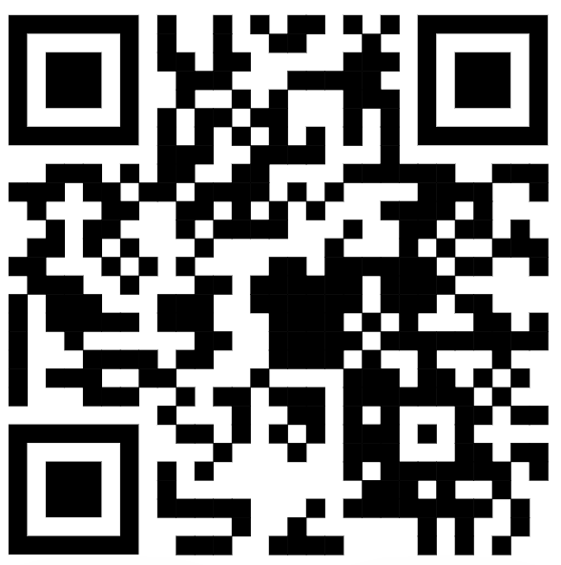
https://mmd.muni.cz/
PhD Day 2024
Luděk Bláha, vice-dean for PhD, SCI MUNI

Slide 2
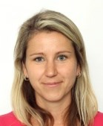
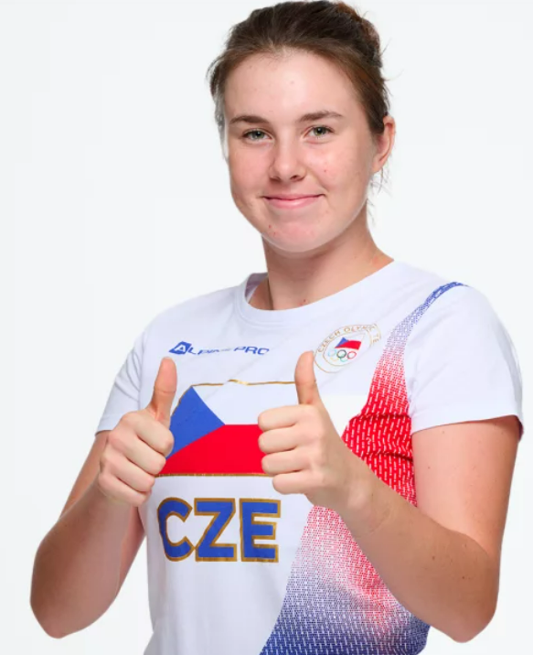
HR Award at SCI MUNI – HR Excellence in Research, HRS4R
HR Excellence in Research Award is an award by European Commission granted to institutions that implement the new HR (Human Resources) Strategy for Researchers (HRS4R).
SCI MUNI gained it in 2018 and has to renew it in the end of 2024/during 2025.
HR Excellence in Research Award is our commitment to foster an open and international work environment and culture, support career development, share information & opportunities, and establish transparent recruitment and onboarding procedures for worldwide researchers including PhD students as a first stage of their research careers.
The HRS4R implementation includes the Early-stage Researchers development and mentoring concept at SCI MUNI: Development Strategy, PostDoc web, PhD web, trainings, support provided by our Development Specialist for Early-stage Researchers.
HR Excellence in Research Award is linked to the new European Competence Framework for Researchers. Check competencies crucial for your research career!
Share with us your views - questionnaire will be distributed after the PhD Day.
Your opinions expressed in Questionnaire Surveys in previous years you can find here

Slide 3
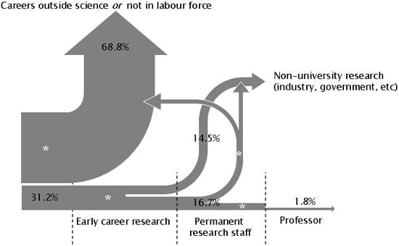


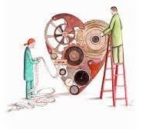
Ready for Science? … for Research? … for PhD?
Love and passion
Determination
& Career planning
Responsibility
Notes:
Love science! Want to advance and contribute!
Many different ways how to be involved … and just one is PhD (others are research technician etc etc)
PhD – independence, desire to work on your own, take responsibility, become leader
Important decision and career step
Demanding task and obligation for 3-4 years and much beyond
Obligation and contract for all parties
Students
Supervisor(s)
Doctoral Boards!

Slide 4
Improving quality of PhD training at MUNI and aligning with international standards

Slide 5

Improving quality of PhD training at MUNI and aligning with international standards
Science 1st!

Slide 6
Improving quality of PhD training at MUNI and aligning with international standards
Science 1st!
Preparation for following career
Independence and responsibility building
Duration (3-4 years) corresponding to career planning
Interdisciplinary & Intersectorial experiences
Transferable and soft skills

Slide 7
Improving quality of PhD training at MUNI and aligning with international standards
Science 1st!
Preparation for following career
Independence and responsibility building
Duration (3-4 years) corresponding to career planning
Interdisciplinary & Intersectorial experiences
Transferable and soft skills
International (global) network & mobility

Slide 8

MMD helps
Established 2022 to commemorate 200th birthday of GJM
Science 1st!
Preparation for following career
Independence and responsibility building
Duration (3-4 years) corresponding to career planning
Interdisciplinary & Intersectorial experiences
Transferable and soft skills
International (global) network & mobility
Elements and criteria
Be pro-active (student <> supervisor <> Doctoral Board)
Seminars – MMD & beyond
Learn more
Summer schools
Secondments in industry
Communication, leadership
Doctor Europaeus
3 months abroad
International defence

Slide 9





How MMD works …
XD007 in IS MUNI as a tool
< each semester >
Evaluation of the Application by MMD Committee
Monitoring of participation in centrally offered courses
Enrollment to MMD Programme
[IS MUNI course XD007]
Preparation and uploading of the Application Dossier
`
[
]
3 months
international
secondment
Motivation, interest and support
- Student, Supervisor, PhD Board
Show your activities
E.g. Previous engagement
Deadline: 29 Sept 2024
Results announced
4 Oct 2024
End of semester:
short report (describe your efforts – also other non-MMD activities)

Slide 10

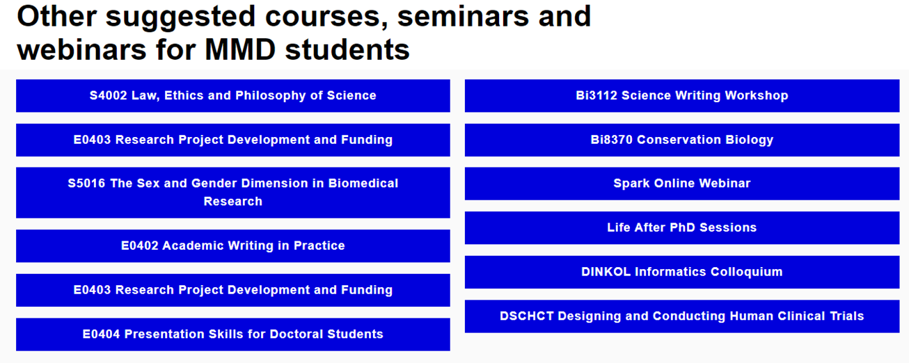
MMD offers interdisciplinary trainings
And/or be active,
join other trainings
(and report your activity at the end of semester)

Slide 11
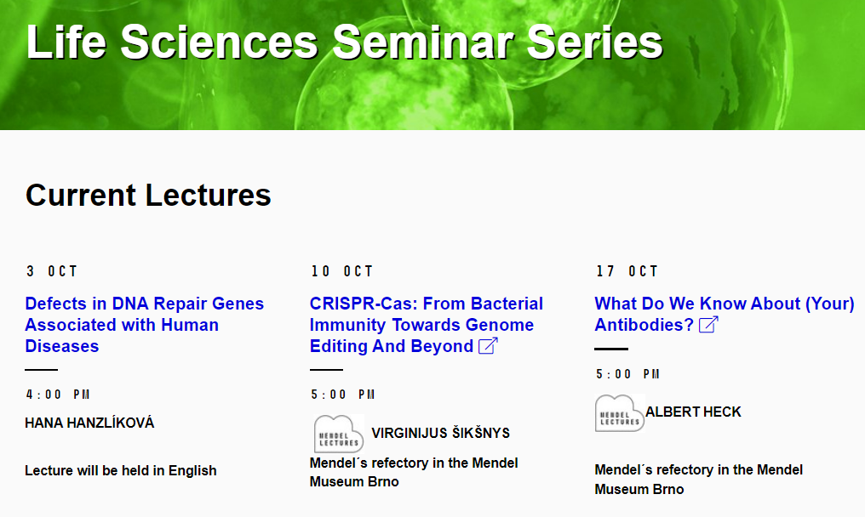
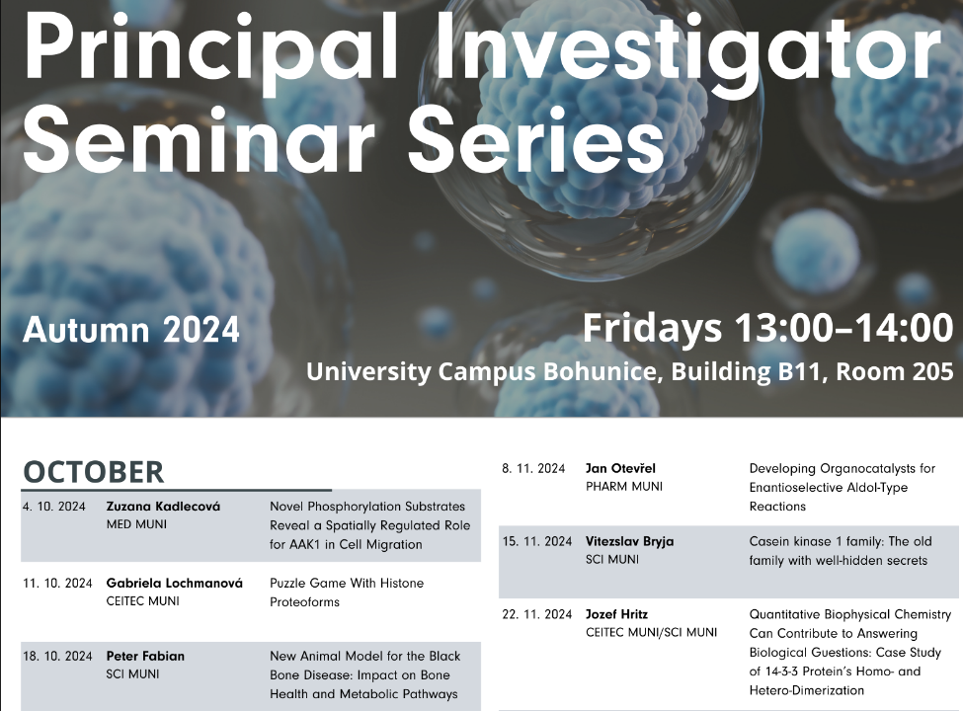
MMD offers interdisciplinary trainings
And/or be active,
join other trainings
(and report your activity at the end of semester)

Slide 12
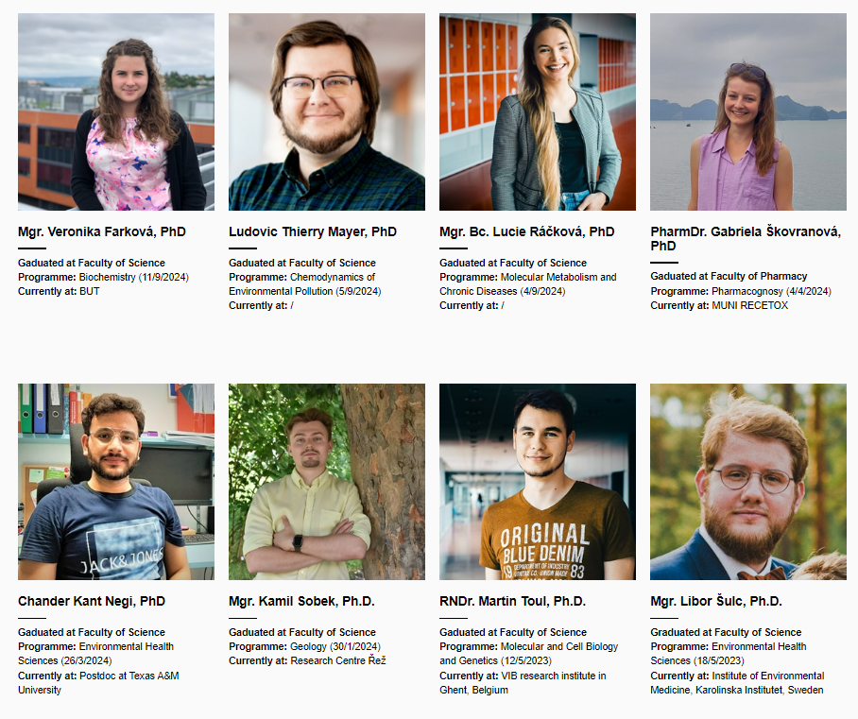
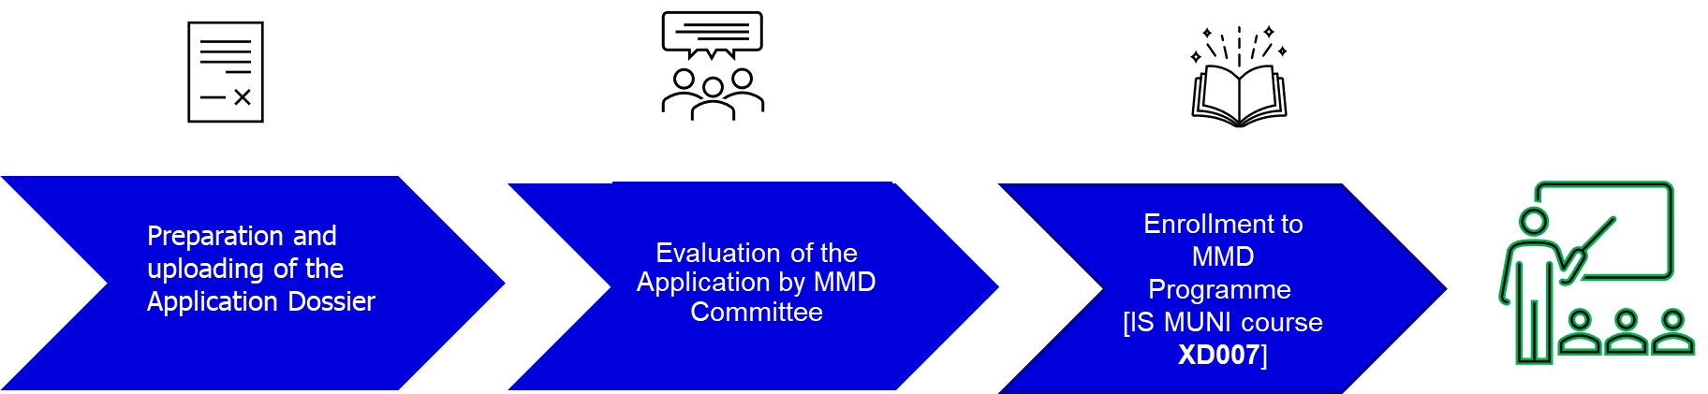





How MMD works …
Finishing and submitting doctoral thesis in English after 4(+1) years
Oral thesis presentation and defence in European Doctorate format
MMD & European Doctorandus certificates
International
reviewers
& committee

Slide 13
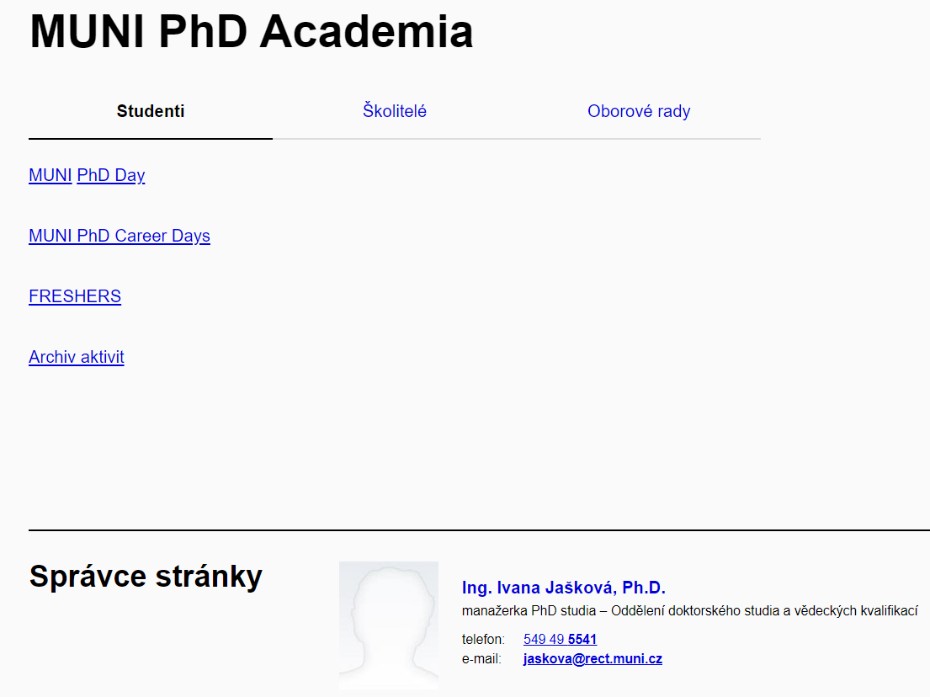
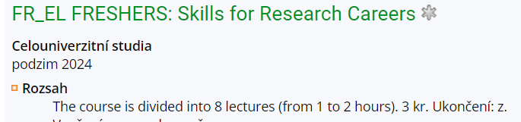
We coordinate with other MUNI support to PhDs …
https://portal.muni.cz/vyzkum-a-projekty/doktorske-studium/muni-phd-academia
Financing Research
Research Integrity and AI
Research Ethics
Scientific Evaluation; Scientometrics and Publication Ethics
Open Science
Introduction to Intellectual Property Law
Communicating Science; Promotion of Research Results
Research Infrastructures

Slide 14

Ready for Science? … for Research? … for PhD?
Then, you should TRY
Notes:
Contipro – stánek na coffee, career and interdisciplinary experiences…

