Slide 1
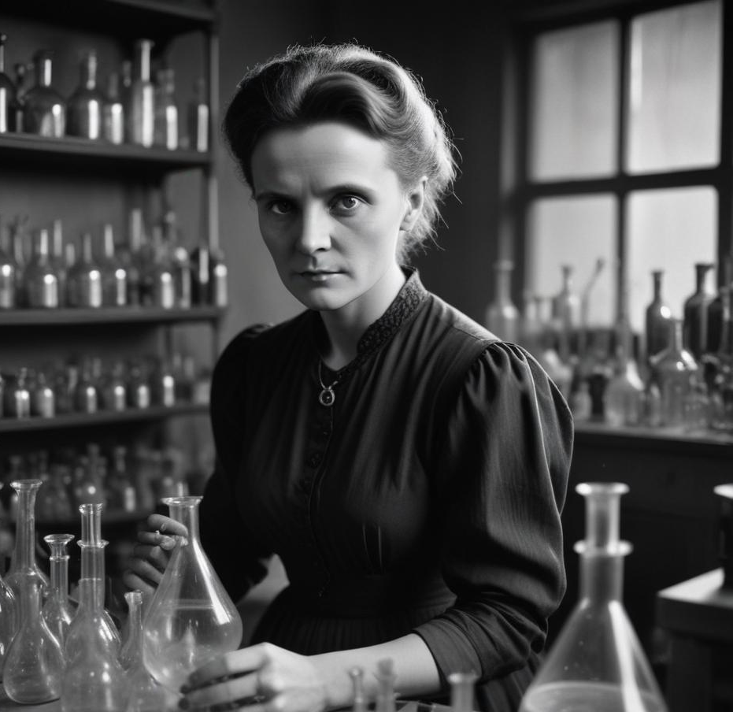
MSCA Postdoctoral Fellowships 2025
presentation by SCI MUNI Project Support Office February 2025

Slide 2
WHAT is an MSCA-PF
a part of the bigger EU programme Marie Sklodowska-Curie Actions
a prestigious grant scheme for support of researchers in early stages of their scientific career
a great opportunity to receive a generous financial support for a comprehensive professional development and starting a research in a new topic/field – including alternative grant support schemes (!)
a valuable experience, useful in your future grant projects
for universities, it is an opportunity to recruit talented scientists from abroad

Slide 3
THE TWO VARIETIES OF PFs
European Postdoctoral Fellowships for researchers who wish to implement their MSCA PF in the institution located in EU Member States or Horizon Europe Associated Countries The standard duration is 12-24 months*
Global Postdoctoral Fellowships for researchers who wish to implement the MSCA PF outside EU Member States and Horizon Europe Associated Countries The standard duration is 24-36 months*, divided between: a) outgoing phase of 12-24 months in non-associated Third Country, then a mandatory b) return phase of 12 months in EU Member State or a Horizon Europe Associated Country
*Projects may also include "non-academic placement" for an additional period of up to 6 months spent academic sector.

Slide 4
ELIGIBILITY
The candidate must be a PhD holder, who spent no more than 8 years working in research (excluding career breaks, maternity/paternity leaves, long term long term sick-leaves etc.)
The candidate must meet the mobility rule, which reads as follows: „must not have resided or carried out the main activity (work, studies…) in the country of the beneficiary (for EU Postdoctoral Fellowships), or the host organisation for the outgoing phase (Global PFs) for more than 12 months in the 36 months before the call deadline.“
Nationality:
For European PFs: any nationality from anywhere
For Global PFs: EU nationals or long-term residents

Slide 5
MSCA-PF 2025 TIMELINE
this year‘s call opens on 9th April 2025
there will be seminars and workshops for applicants/supervisors during spring 2025 (dates to be announced)
deadline to submit the proposal is 10th September 2025 at 5 PM
results of the evaluations will be published approx. 5 months later (02/2026)
writing and refinement of a good proposal takes up to several months (we assume the applicants and supervisors have other duties too!)
highly recommended to start early, conceptualize during March/April, write and consulting, proofreading and technicalities throughout April – August.
reserve time for summer vacations

Slide 6
HOW TO APPLY
The application form is electronic and is filled in Funding & Tenders Portal of the European Comission.
the last year‘s form available here (the new one will be published shortly)
It consists of:
Part A: information about participating organisation(s), the supervisor, ethics self-assessment etc.
Part B-1: the scientific part of the proposal
Part B-2: CV of the candidate, capacities of the participating organisations, their letters of commitment (Global PF-only), additional ethics/security issues, if applicable, environmental considerations etc.

Slide 7
HOW THE P.S.O. CAN HELP YOU
Once we know you are a prospective MSCA-PF candidate …
we will provide you with our MSCA-PF package*
we can help you set up your access to Funding & Tenders Portal and start the application form there
we can help you with the technical part A of the proposal (info about MUNI, the ethics assessment, etc.)
we can provide limited** feedback to scientific part B for your proposal
we will help with the necessary university administration (budgeting, ISEP … )
* this includes application templates, presentation(s), brochures with tips/do‘s and don‘ts both made by MUNI colleagues and the EU, Gantt charts and other tools, which will – hopefully – help you. ** please note that we are laypersons in your particular field, so our feeback concerns mainly evaluation criteria and patterns of good practice, the scientific part is to be consulted primarily with the supervisor

Slide 8
HOW TO WRITE A GOOD PROPOSAL
Have a good supervisor, as his/her role will be crucial for the eventual success
Time is of the essence, reserve enough of it (both you and your supervisor)
Focus rigorously on the evaluation criteria and try to avoid common mistakes
Revise your proposal time and time again with your supervisor
Don‘t forget about the technicalities (the lenght of the proposal, the margins, the font size, the references, diagrams … little details matter also)
Did we mention the meetings and consulting with your supervisor regularly? (really, it‘s important)

Slide 9
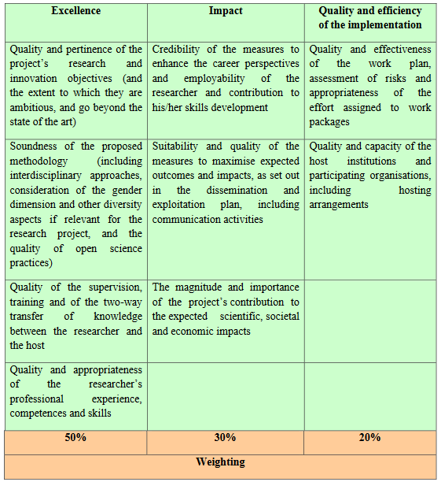
PROPOSAL EVALUATION
the proposal is evaluated by a panel of evaluators, consisting of a mix of generalists and specialists (minimum 3)
takes about 5 months
there are 3 evaluation criteria:
EXCELLENCE
IMPACT
QUALITY OF IMPLEMENTATION
described in detail as follows:

Slide 10
MSCA-PF FUNDING
if awarded the candidate receives the grant consisting of:
living allowance (= competitive salary)
travel allowance
family allowance, if applicable
special needs, if applicable
long-term leave allowances, if applicable
the host institution receives the support for:
RTN (research, training and networking) of the candidate
management and indirect costs

Slide 11
… BUT THAT‘s NOT ALL!
The MSCA PFs are, admittedly, highly competitive:
in the 2024 call, for instance, there were 10 360 submitted proposals (both EF & GF)
1696 of them were selected for funding
= SUCCESS RATE OF ~16,5% (which is not very much, but not impossible either!)
Also, since we are situated in the Czech Republic (one of the Widening countries):
excellent proposals ending „just below the line“ may be eligible for a substitute
ERA-Fellowship Funding (you apply for it directly in the MSCA-PF application form)
additional 41 ERA-fellowships were awarded in 2024 call
Furthermore, any proposal scoring over 70% may be eligible for a substitute funding from the national OP Jan Amos Komensky
the BIG advantage: success rate is then, by contrast, very high, around 80%
currently available only till August 2026, so the time is nigh, don‘t delay!

Slide 12
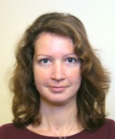
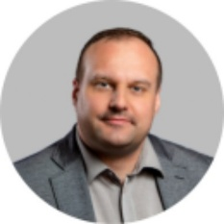
Thank you for your attention.
Do you have any questions? Do you consider applying?
Please don‘t hesitate to contact us!
Mgr. Kateřina Ježová, Ph.D.
Research Projects Manager
(for departments at University Campus Bohunice)
Tel: +420 549 49 6662 E-mail: jezova@sci.muni.cz
In person: Campus Kotlářská
building 3, office 01007a
Bc. Tomáš Lády
Research Projects Manager (for departments at Campus Kotlářská) Tel: +420 549 49 4187 E-mail: lady@sci.muni.cz
In person: Campus Kotlářská
building 3, office 01007a

