Slide 1
Networking & Opportunities: The snowball effect
Barbora Jankovičová
Faculty of Science, Dpt. of Experimental Biology, Section of Microbiology

Slide 2


Who is Barbora Jankovičová?
BSc and MSc in Molecular biology and genetics
4th year PhD student of Microbiology
Research topic:
Engineering of bacteria for valorization of waste plant biomass

Slide 3
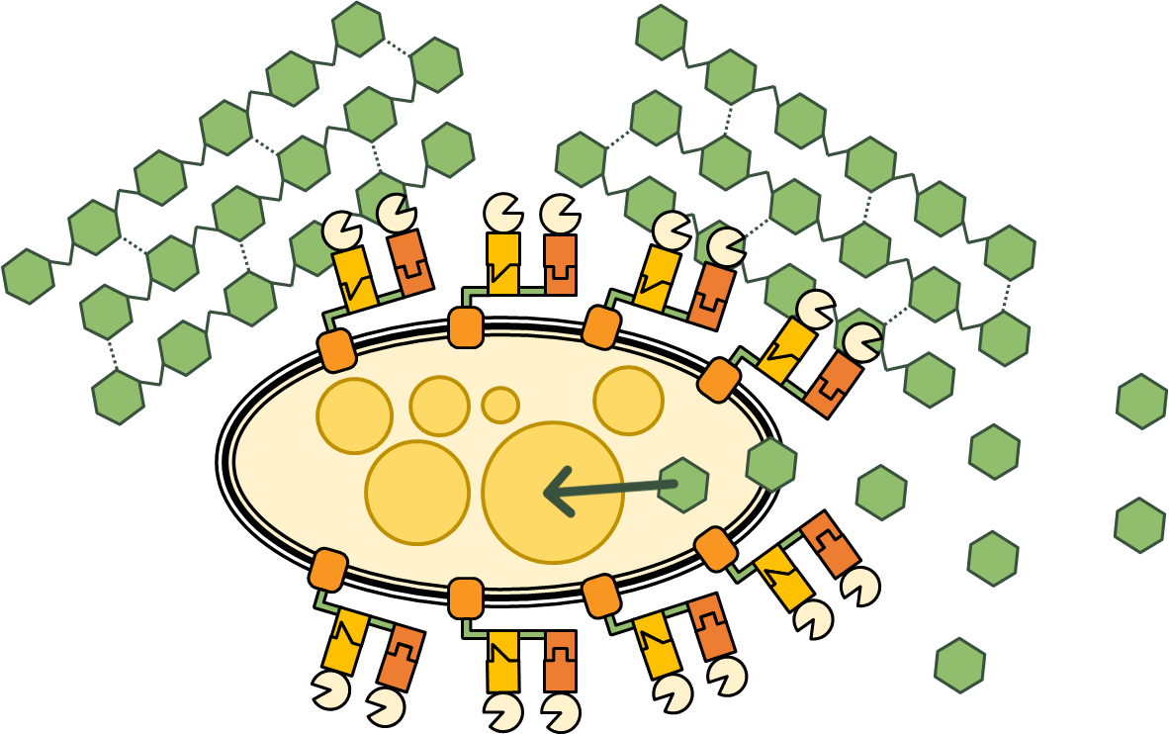

Slide 4
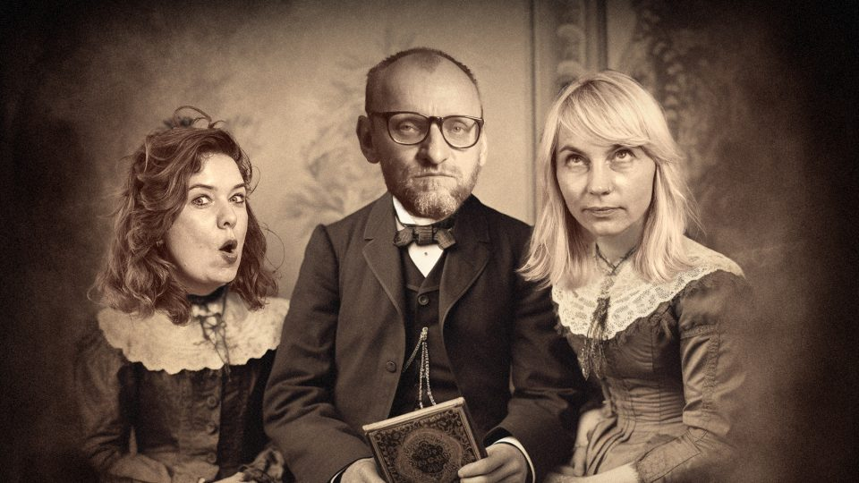
High school
prof. Zajíček: extracurricular projects
Be the teacher you wish you had
Guide students to doing extracurricular activities
Notes:
During my bachelor studies, I found a group of friends who were as motivated as I was, and we were able to help and support each other and lift each other up when things got hard, which was a great help.
Another very important turning point during my bachelors was when I decided to apply to join a lab. I wanted to focus on genetic engineering and synthetic biology, because the possibility of fine-tuning living organisms fascinated me.
I chose a lab that was just being established, and the PI told me that he didn‘t have the resources for any more students at that time, but to try in half a year. So I waited and tried again, and I got accepted! Pavel Dvořák, my PI, later told me that it was my determination and knowing what I want that persuaded him to accept me.
So, I started going to the lab, and one of my friends, Standa, later joined me there.
Also, during that time, I felt like I wanted to do something more, some extracurricular project, as I was used to duting high school. That‘s where iGEM comes in…

Slide 5
Bachelor studies
Group of motivated friends
Got accepted to the lab of my choice on the second try
Feeling like I wanted to do something more…
Surround yourself with like-minded people
Go after the thing you want
Show your determination
Notes:
During my bachelor studies, I found a group of friends who were as motivated as I was, and we were able to help and support each other and lift each other up when things got hard, which was a great help.
Another very important turning point during my bachelors was when I decided to apply to join a lab. I wanted to focus on genetic engineering and synthetic biology, because the possibility of fine-tuning living organisms fascinated me.
I chose a lab that was just being established, and the PI told me that he didn‘t have the resources for any more students at that time, but to try in half a year. So I waited and tried again, and I got accepted! Pavel Dvořák, my PI, later told me that it was my determination and knowing what I want that persuaded him to accept me.
So, I started going to the lab, and one of my friends, Standa, later joined me there.
Also, during that time, I felt like I wanted to do something more, some extracurricular project, as I was used to duting high school. That‘s where iGEM comes in…

Slide 6

iGEM – what is it?
International Genetically Engineered Machine:
the world‘s biggest competition in synthetic biology
A multidisciplinary team works on a bio-based project that could help solve a local or a global problem
Do the research, secure finances, run the lab, communicate with the public, present your results → experience the whole scientific process
Build a network
Notes:
First, I should explain what iGEM means and what it is. The shortcut stands for International Genetically Engineered Machine, and it is the biggest competition in synthetic biology in the world. It was originally established at MIT in 2003 and since then, more than 80 000 students from more than 65 countries paticipated in it.
In iGEM, the students in multidisciplinary teams come up with a bio-based project that could help solve a local or a global problem. They do their research, design the project, do the experiments and present their results, and at the end, they are evaluated by a panel of judges. It‘s basically like working on a grant, but in a smaller scale. And it‘s not only about the science – the team also needs to fundraise quite a lot of money, and the competition also strongly encourages science communication and work with the general public.

Slide 7
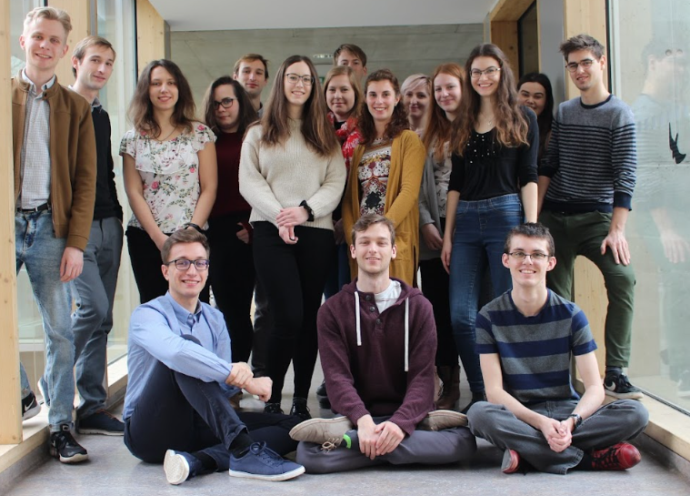
Planting the seed of iGEM
Biomania Student conference: iGEM ambassador for Europe
Friend group → core team, then a campaign to find more people
Participate in conferences,
Don‘t be afraid to talk to the speakers
Notes:
The first time I heard abot iGEM was at the first ever conference I attended – the Biomania Student conference. One of the speakers was the iGEM ambassador for Europe. Together with my friend Standa (the one who was in the same lab as me), we heard his talk and decided to go talk to him during a coffee break. We got excited about the idea of starting our own team in Brno. We spoke about it with our PI and he supported us. Only later we realized that he, as the organizer of the conference, probably invited the ambassador with the goal of inspiring us to do it ☺
After the conference, we talked to our friend group, and most of them were as excited as the two of us. So that was how we formed the core team. A few weeks later, we made a campaign and found more people to join the team. When the team was complete, we had to deal with other major things before we could start working on the project itself.

Slide 8



iGEM – the major hurdles
Supervision: Karel Říha (CEITEC), Martin Marek (Loschmidt Laboratories), Pavel Dvořák (MBL)
Lab space: Jiří Doškař (LMDM)
Finances: Tomáš Kašparovský (SCI MUNI)
Don‘t be afraid to ask for help and support
Provide the support if you can
Notes:
First and foremost, we had to find qualified supervisors and official team leaders. Me and Standa contacted more than a dozen of PIs and group leaders that work on genetic engineering in Brno, and pitched them our idea. In the end, three of them agreed to join us – our PI, Pavel Dvořák, and then Martin Marek from the Loschmidt Laboratories, and Karel Říha, the Deputy Director for Research at CEITEC. They invested a lot of their time and effort into our project even though there was nothing in in for them other than a good feeling, and we appreciated, and still appreciate, it a lot.
The second thing we needed to sort out was the lab space – ideally, we needed a full access to a GMO-certified lab over the whole summer. We managed to get that from the Laboratory of Molecular Diagnostics of Microoorganisms – professor Doškař practically gave us one of their labs at our full disposal.
The last major thing we needed to handle before officially starting was money. iGEM is an international competition, but its based in the US, and sadly, the participation fee is quite steep – the early bird fee is 5500 USD, which is more than 120 000 CZK. And that‘s not the only cost – we had to purchase all the chemicals and reagents we wanted to use in the lab, and later pay tickets for participation in the closing conference at the end of the year. Luckily, we managed to get the money quickly – we met with the dean of our faculty, professor Tomáš Kašparovský, and he very generously agreed to cover all the fees.
So, my recommendation here for the students is to ask for help, and for the policy makers to provided.

Slide 9
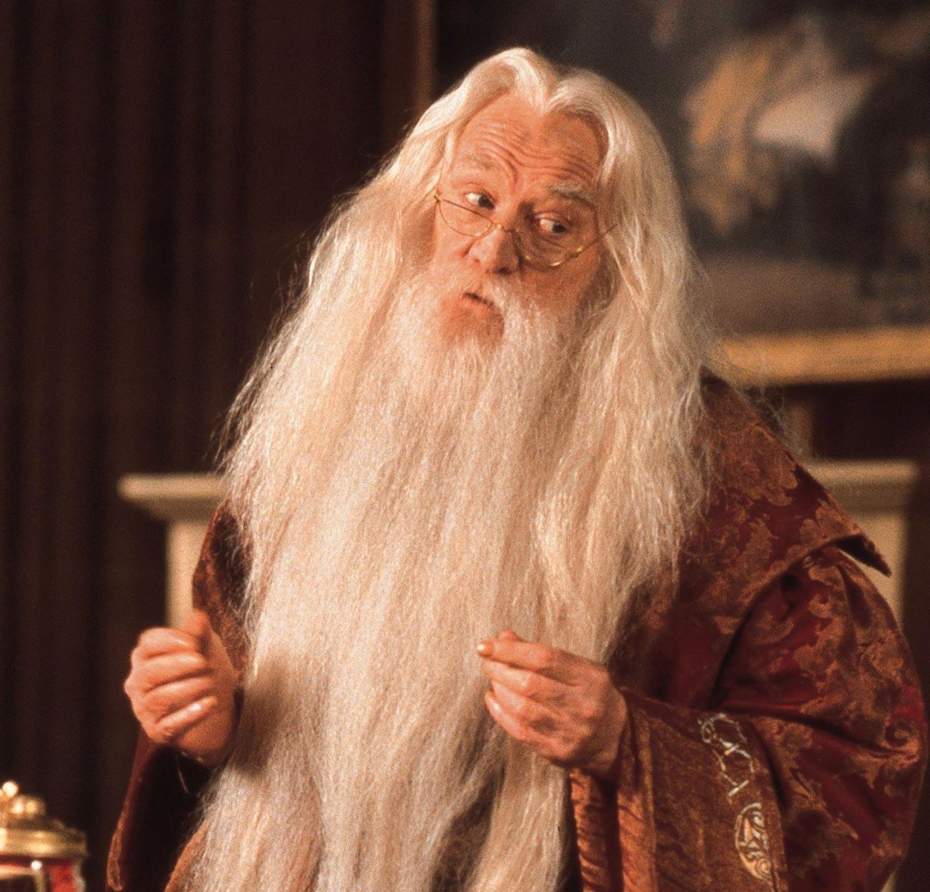
However, you will find that help will always be given at Hogwarts in Brno to those who ask for it.
Notes:
In my experience, we always got the help we needed, and I‘m sure it will continue to be so for the younger students.

Slide 10
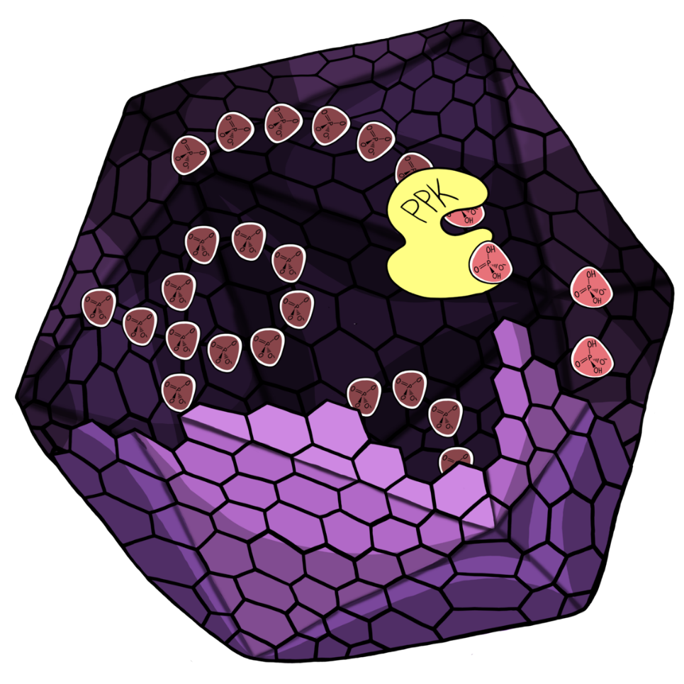
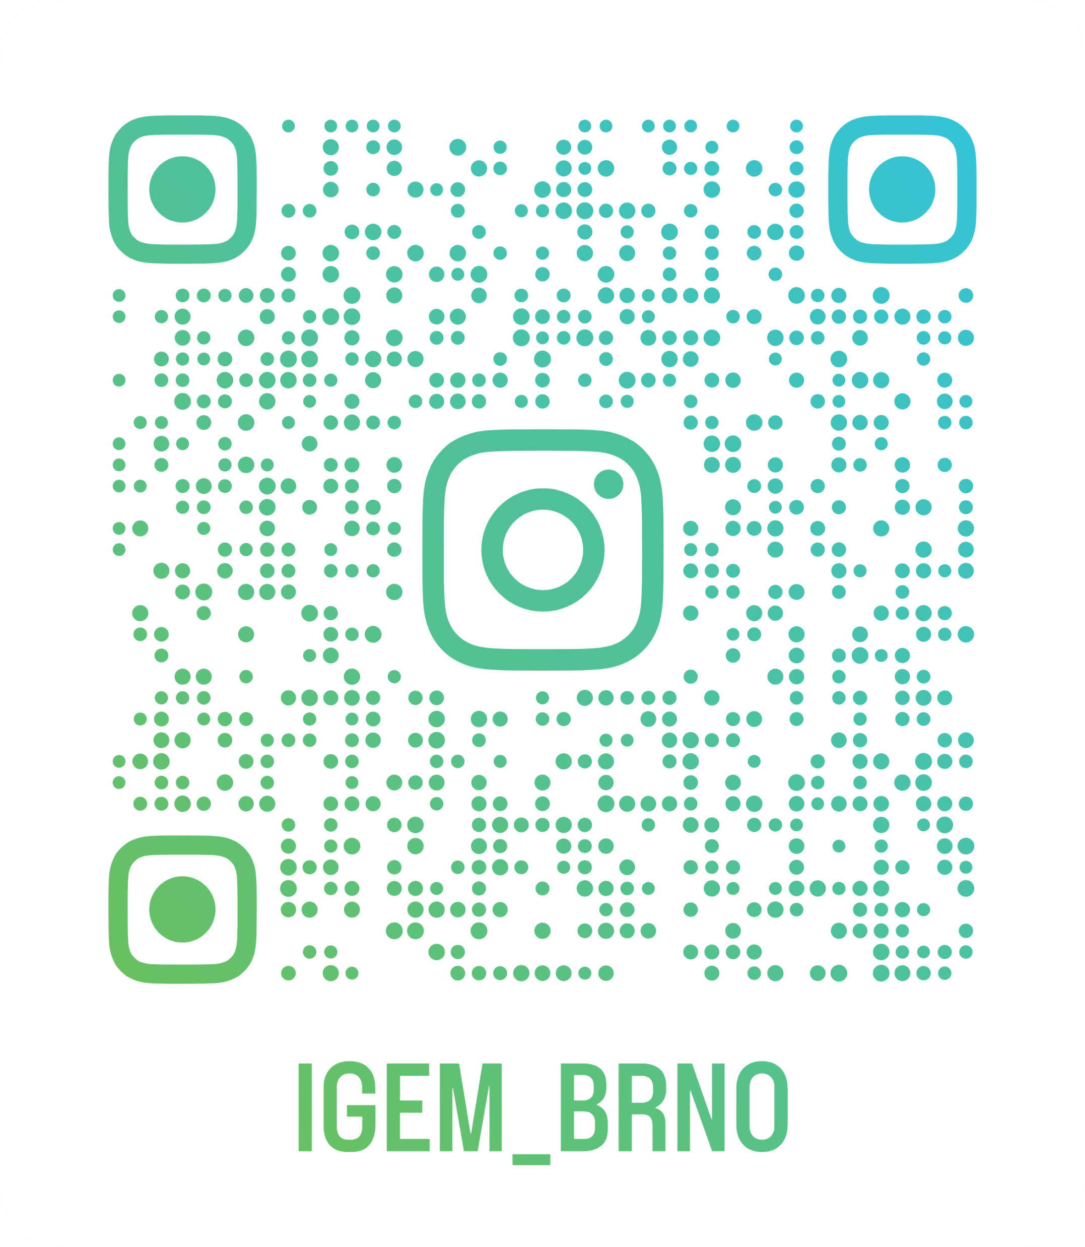

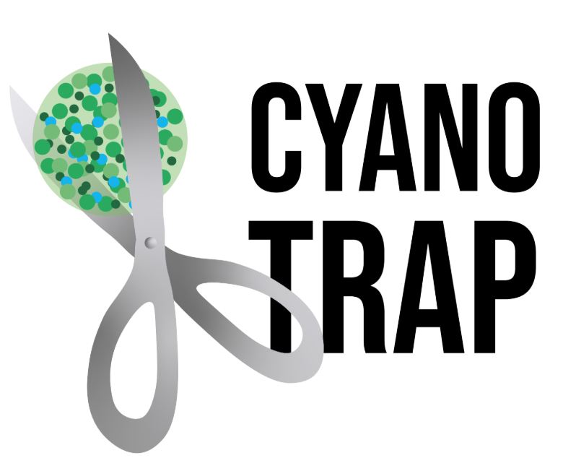
iGEM – projects done in Brno
2020: Cyanotrap
2021: Phoscage
2025: NitroDuck
Notes:
Now, I would like to tell you a little bit about the iGEM projects done here in Brno. In 2020, me and my team came up with a project called Cyanotrap. We wanted to make a machine that would clean water from cyanobacteria and their toxins. In 2021, we continued with the same general direction, but instead on solving the resulting cyanobacterial bloom, we focused on ins cause – the excess phosphorus in water. We designed a system in which our bacteria would take up the phosphorus from water and store it in so-called microcompartments.
After these two projects, the people in our team felt they needed to focus on other things than iGEM, and Brno did not participate for several years. However, I am very happy to say that a new team has been formed – maybe you already heard about their project, which is called NitroDuck. If you want to learn more about it, give them a follow!

Slide 11
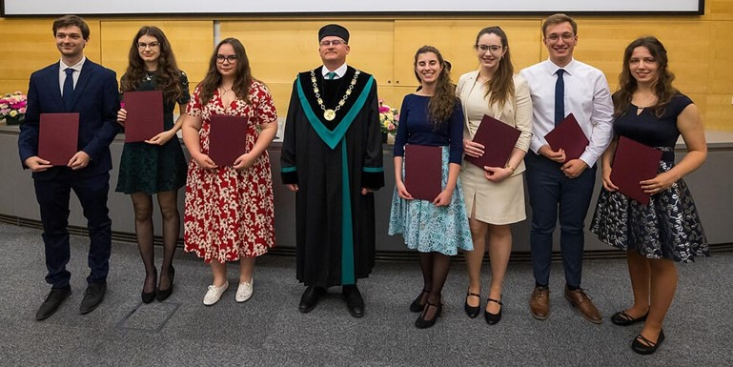
iGEM – a rewarding experience
Hands-on experience: science, finances, communication
Great group of friends, a lot of fun!
Dean‘s Award
Look for opportunities to get more experience
Have fun while learning ☺
Notes:
Despite all that, iGEM was also a great and a very valuable experience. We all learned a lot – we went through things that people usually go through during their PhDs or postdocs (and we were just bachelor students when we started). As I already said when I was describing what iGEM is about – we went through the whole process of a scientific project, we had to find and manage our finances, we communicated our science to the general public, and so on and so on.
We also created an amazing group of friends, that will hopefully last for a lifetime, and we had a lot of fun together. Here is a picture from when we received the Deans Award at Faculty of Science.
For me personally, iGEM was the thing that started the snowball effect. I got connected to many interesting people through iGEM, and thanks to our success in both years, we captured the attention of media. It is a great point in my CV, and I feel like it opened many doors for me.

Slide 12
Finishing Masters, starting PhD
PhD in the same lab as BSc and MSc
Plus: Great team and environment, interest in the project, feeling of security
Minus: Not having the international experience, scientific inbreeding
Give yourself enough time and energy to spend on making important decisions
Consider multiple ways to move forward
Notes:
The second year of iGEM finished in the middle of my second year of Masters. It was a time when I was deciding where I would go for a PhD. Early on, my PI told me that if I wanted, he‘d be happy to keep me for PhD. I liked the project, the team and the whole department, and the feeling of security it offered. However, to be quite honest, the convenience of it also played a role. One of my friends was applying for a position abroad and I saw how much time and energy it required, and that was only the application process and interviews. Being exhausted from iGEM, I decided that I don‘t want to deal with finding a position abroad, let alone moving and everything. So I decided to accept the offer from my PI and stay. Of course, it has many positives, but also some negatives that I didn‘t really think about at that time.
Staying in the same lab for all your degrees is called scientific inbreeding, and in reality it means that you did not experience various topics and environments, which is not good for your development as a scientist. Also, to be successful in receiving grants later in your career, you need to have substantial experience from abroad. If I have done that during PhD, I could have come back to Czechia for a postdoc and for my career after that. Because I haven‘t done it, I‘ll need to go abroad after my PhD, if I want to stay in academia.

Slide 13

PhD studies
Brno PhD Talent
Practice in writing grant proposals, project outline
Financial support for 3 years
Workshops → improve soft skills
Apply in September during your 1st year
Apply!
Attend workshops to improve yourself

Slide 14
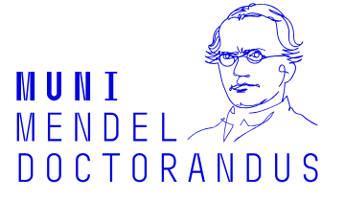
PhD studies
MMD
Community of motivated students
Doctor Europaeus
Interdisciplinary lectures – get a broader scope of science
Soft skills training required
Newsletter/e-mail notifications!
Apply!
Make your diploma stand out

Slide 15
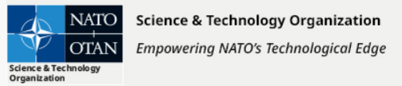
Outside opportunities: NATO ECSE
NATO Science and Technology Board
Dual-use technology – civil and defense application
Best Presentation Award
Read newsletters
Apply for interesting events
Notes:
While waiting for an experiment to finish, I read a newsletter in which I found the call to apply for NATO ECSE – I still had several hours to wait, so I decided to spend the time writing the application, and it paid off ☺ it also taught me to think about my project in a broader perspective
NATO ECSE best presentation → award received from Dr. Bryan Wells → invitation to STEM Forward → participation in NATO Women in Science → NATO Biotech workshop in May → maybe a future career opportunity
Advice for students: read the newsletters! Apply for interesting events!
To the „people in power“: support your students in extracurricular activities

Slide 16
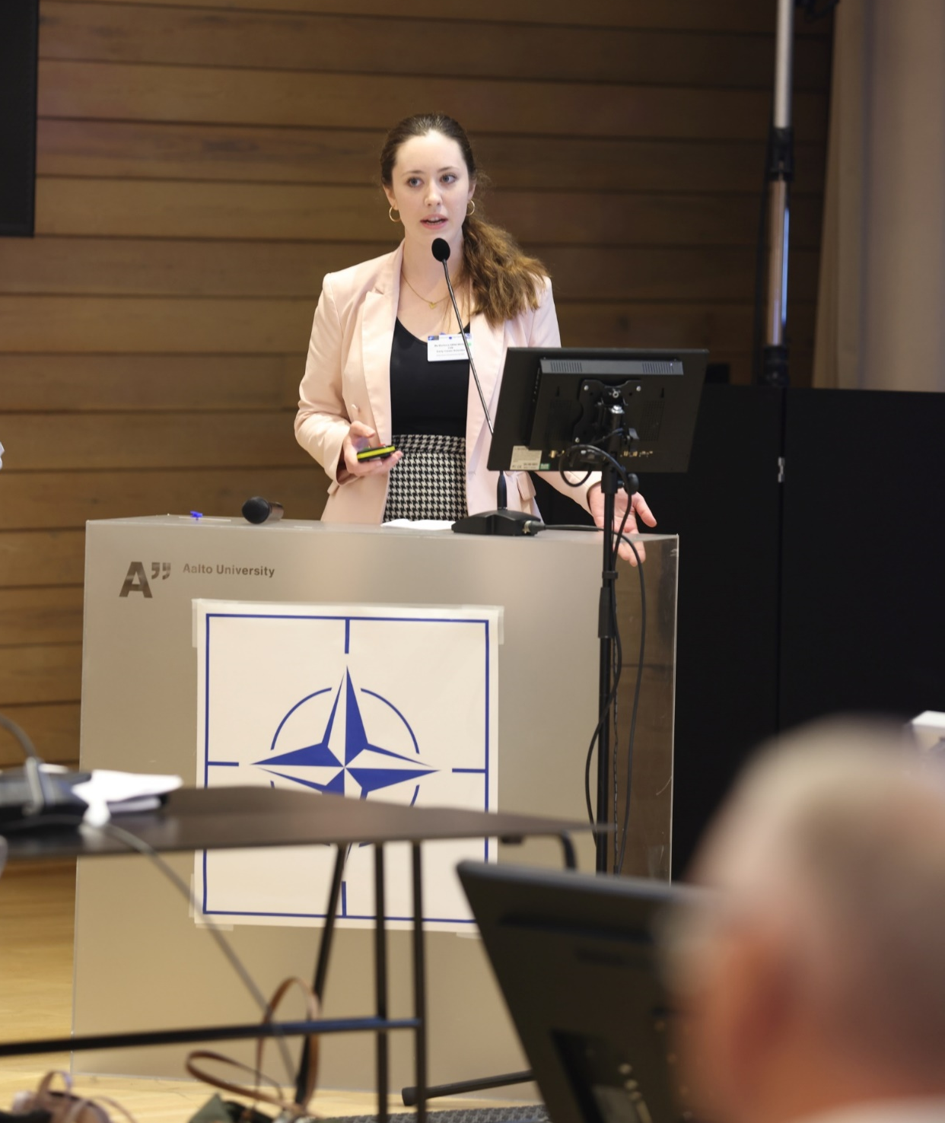
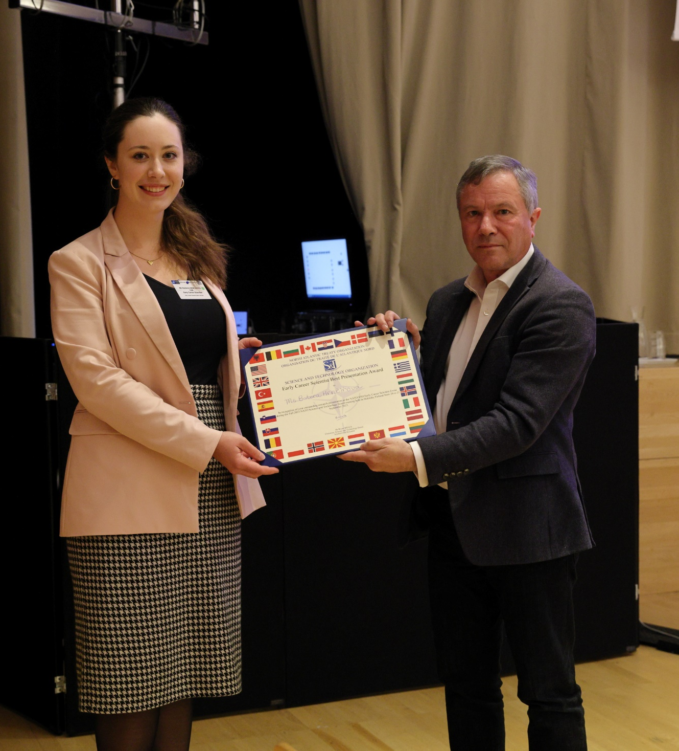
Notes:
While waiting for an experiment to finish, I read a newsletter in which I found the call to apply for NATO ECSE – I still had several hours to wait, so I decided to spend the time writing the application, and it paid off ☺ it also taught me to think about my project in a broader perspective
NATO ECSE best presentation → award received from Dr. Bryan Wells → invitation to STEM Forward → participation in NATO Women in Science → NATO Biotech workshop in May → maybe a future career opportunity
Advice for students: read the newsletters! Apply for interesting events!
To the „people in power“: support your students in extracurricular activities

Slide 17
Get your foot in the door
NATO ECSE Best Presentation → STEM Forward → NATO Women in Science → NATO Biotech workshop → future job?
Keep in touch with people after events, internships etc.
Notes:
While waiting for an experiment to finish, I read a newsletter in which I found the call to apply for NATO ECSE – I still had several hours to wait, so I decided to spend the time writing the application, and it paid off ☺ it also taught me to think about my project in a broader perspective
NATO ECSE best presentation → award received from Dr. Bryan Wells → invitation to STEM Forward → participation in NATO Women in Science → NATO Biotech workshop in May → maybe a future career opportunity
Advice for students: read the newsletters! Apply for interesting events!
To the „people in power“: support your students in extracurricular activities

Slide 18

Outside opportunities: GYSS 2025
Global Young Scientists Summit in Singapore
Applied already for GYSS 2024 → not selected, applied again for GYSS 2025 (after ECSE) → selected!
If it doesn‘t work out for the first time, try again!
Improve your CV in the meantime to make chances better

Slide 19
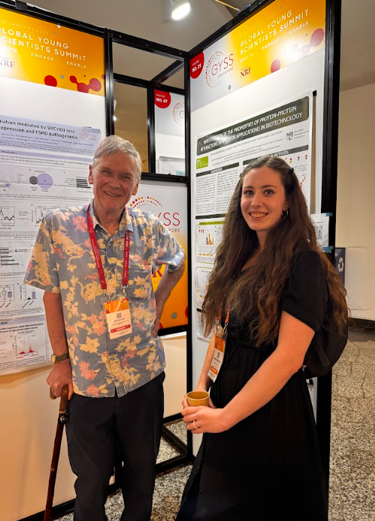
Highlights from GYSS 2025
Research infrastructure of Singapore
Inspiring life stories of Nobel laureates
Women in Science workshop
Bridge between science and policy
Visit Singapore and get inspired!
Notes:
Learned about the research infrastucture of Singapore → Advice for students: if you want to study abroad, definitely consider Singapore!
Inspiring life stories of Nobel laureates – science is hard work, but it is not only about that
Talked to a Nobel laureate sir Tim Hunt ☺
Workshop on Women in Science by Joan Rose and dame Sue Black → Advice for students: support each other, find a senior „advocate“ that can emphatize with you and help you if you face a problem/feel discriminated against; be the advocate for others!
Solving global problems through innovation → we should really focus on science communication and talking to policy makers if we want to get our results from the lab to the real world

Slide 20
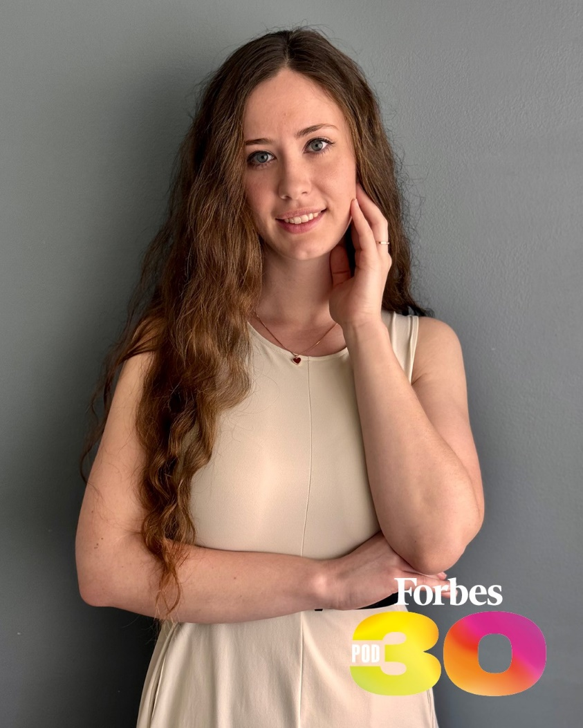
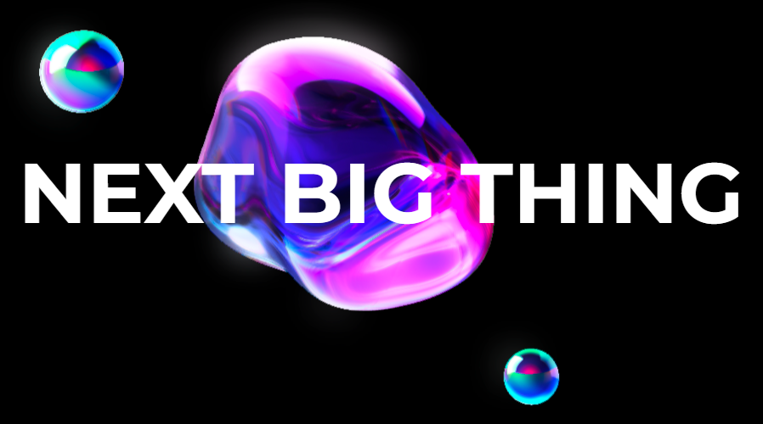
Forbes 30 under 30 Czechia
Currently the outer layer of my snowball ☺
Inspiration, networking, platform
Events: Next Big Thing
Try to see what your field looks like outside of academia
Notes:
iGEM → PhD Talent → NATO ECSE → Forbes 30u30
Current stage of the snowball effect, let‘s see what‘s next :D
I thought it was a scam at first ☺
Met the other people from the list → huge inspiration
Invitation to events → networking → platform
I have to admit that I‘m not really sure what my next steps to use this award should be

Slide 21
What‘s next?
Finishing PhD!
Starting a family
Postdoc? Private company? Policy making? Science communication? Teaching and supporting others?
Go abroad? Stay here?
Notes:
Finish PhD!
Starting a family
Postdoc? Private company? Policy making? Science communication? Teaching and supporting others?
Go abroad (complication – husband yould have to relocate with me and it would be a complication for his career, no grandparents there – problematic babysitting)? Stay here (complication – lack of long-term experience abroad)?
It feels like I‘m getting more questions than answers about my future right now.

Slide 22
Summary
Surround yourself with supportive people
Be the support for others!
Apply for various opportunities, even if it is a long shot
Work on improving yourself → make your own snowball
Notes:
(family, partner, friends, supervisor, PI, faculty…)
Pros
experience
CV → more opportunities (snowball effect), you can get to places you don‘t even´dream of ☺
meeting intersting people
Cons
time and energy investment
threat to mental and physical health → need to learn to set the boundaries
by opening one door, you might close another
more opportunities → tougher decision (what to focus on)

Slide 23
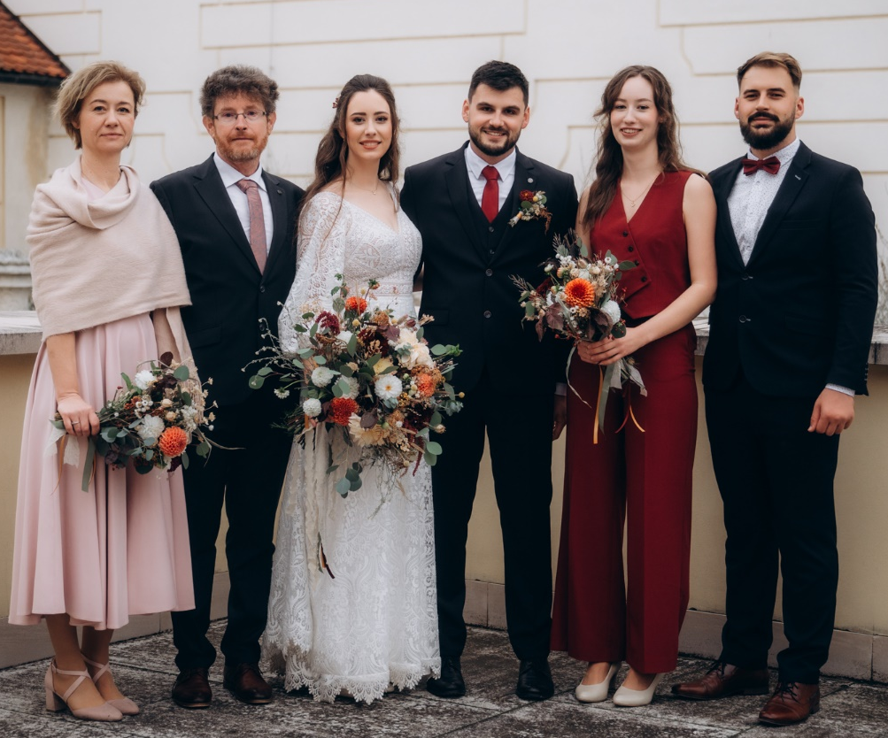
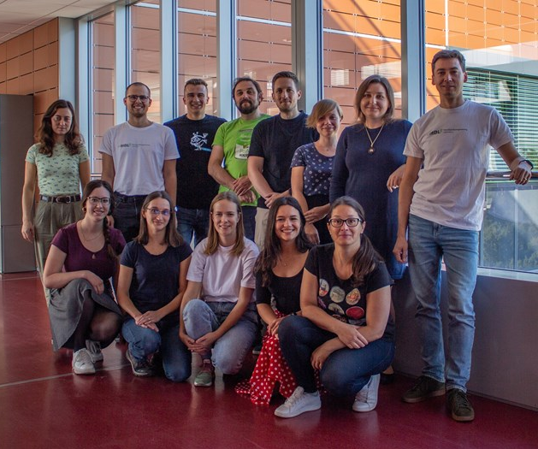




Thank you

