Slide 1


Travel. See the world. Discover your opportunities to go abroad!
Travel. See Erasmus+ Days 2025, 13.10.2025 Mgr. Kristýna Bajgarová, SCI MU
the world. Discover your opportunities to go abroad!

Slide 2

WHY? WHY NOT!

Slide 3

Why should I go abroad?
An experience that will give you an insight into living and studying/working abroad
Gain a competitive advantage on the job market
The uniqueness of staying abroad
New approaches and methods, broaden your horizons in your field
Improving your language skills
Creating new contacts, international connections
Possibility to choose any place for your stay abroad – an institution you would like to cooperate with in the future
Different perspectives, independence, organization, financial literacy

Slide 4

TYPES OF STAYS: 2 OPTIONS
STUDY STAYS
- most often Erasmus+, Erasmus+ ICM, Partner Universities
- takes place at the university
- the choice of university depends on our valid contracts
- at the chosen university you attend their classes, enrol in courses and complete them;
- even on a study stay you can be e.g. in a laboratory - if the foreign university offers it as a subject you can enrol in
- obligation to complete a certain number of credits (usually 20 ECTS/semester)
- usually 1-2 semesters

Slide 5

TYPES OF STAYS: 2 OPTIONS
PRACTICAL STAYS
- sometimes also called work placements/internships/traineeships
- Erasmus+ practical placements (60+ days) or Freemovers (30+ days)
- you can go to any institution - e.g. where you would like to work/get some experience one day
- It is necessary to arrange the internship before applying for scholarship

Slide 6
Erasmus+ study stays
Min. for 3 months and max. for 12 months during the study period
Repeatable (until the student has used up the full 12 months during e.g. a bachelor‘s Studies)
You can apply already in the 1st year of the Bc studies
Where to? Institutional agreements – here
Conditions of selection? Information here
Erasmus+ scholarship (540-660 EUR/month)
1-2 semesters
Bc. and Mgr. students - can apply for a faculty one-off scholarship (programme A.5a, 25 000Kč, application via the IS Document Office)
PhD students - faculty scholarship from programme A.6
Selection procedure once a year:
usually February
1. online application, 2. in-person interview with the committee
Exact dates and selection process will be updated and communicated in January 2026

Slide 7
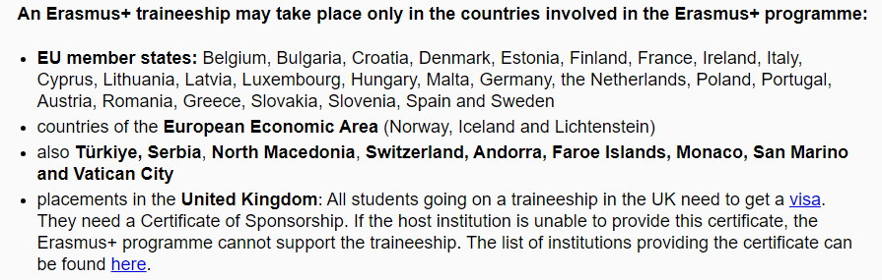
Erasmus+ internships
4 application deadlines every year:
Call I: 31 January (stays from 15.3.)
Call II: 30 April (stays from 1.7.)
Call III: 31 July (stays from 15.9.)
Call IV: 31 October (stays from 15.1.)
At least 2 months = 60 days min., max. 12 months = you can travel for the summer!
The biggest advantage - you can go anywhere, to any institution in the EU
Scholarship (810-690 EUR per month) + possibility of one-time faculty scholarship!
TIP:
Even within the EU member states, you can travel to their overseas territories (Reunion, Martinique, Azores, St. Martin, Fr. Guyana, St. Barthélemy ...)
Here you can find some of the internships offers, but you can also contact any institution you want
Here you can find other student‘s experiences

Slide 8
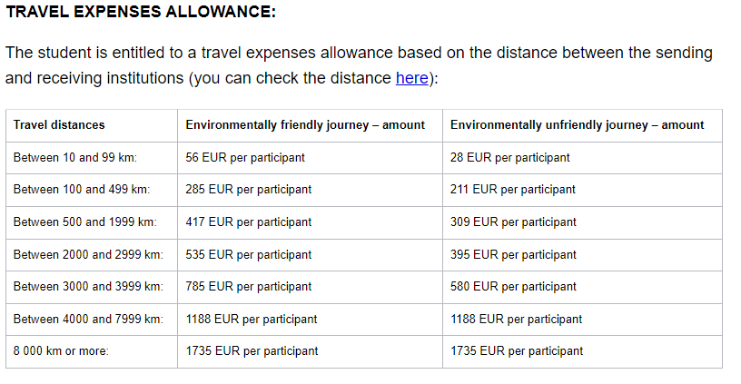
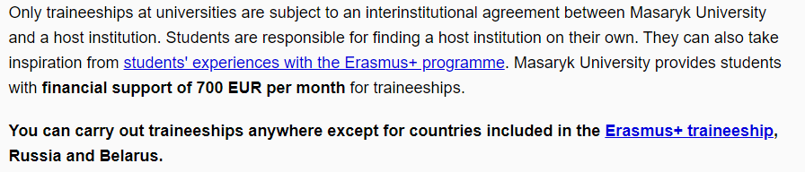
Can I do Erasmus outside Europe?
Yes, you actually can!
From 2025/2026 there is a new option: Erasmus+ internships outside Europe.
Important:
2 – 12 months
Anywhere (any institution)
Scholarships 700 EUR/month + travel expenses
If the traineeship is at a university, we need a contract = we sign it after you are selected!
Currently, students are going to the USA, Canada and New Zealand
Deadlines: same as Erasmus+ internships
More information

Slide 9

Can I go after my state exams?
Yes! There is a graduate traineeship through Erasmus+the traineeship can take place up to 12 months after graduation (including the traineeship period)
the student becomes a graduate on the date of passing the state exam - the traineeship must start and finish within exactly one year from that date the traineeship can last 2-12 months, with each previous Erasmus mobility within a specific study cycle reducing this time (= so if you have already spent 4 months on Erasmus+ during the study you want to go on, you have 8 months left)
the participant must successfully complete the selection procedure BEFORE the end of the studies, i.e. before the state exam date
Don't forget to sort out your health insurance at home - if you are not here and are no longer an active student, you will be obliged to pay for your insurance (or find a job)

Slide 10
FREEMOVER
Study stays
Each university has different rules!
Some freemovers are not accepted at all, in some cases they require tuition fees. In all cases, it is up to the decision of the university whether or not it is interested in accepting the student.
The student must bring 20 ECTS per semester from abroad, the number of credits earned may be lower in the case of short-term thesis preparation, and the student must meet the study requirements of the home faculty.
A letter of acceptance /e-mail is required in the application form.
it is possible to go for shorter stays (1-2 months, for example) to work on a bachelor's or master's thesis - then the number of credits may be lower
Internships
cannot be used for graduate stays = you must be an active student at MU
Learning Agreement for Traineeship directly in the application
The programme is for students who cannot finance their stay through another programme (e.g. Erasmus+)
As a freemover, you can travel to any country in the world for your stay, you make your own arrangements
Min. 30 days, max. 1 semester
Up to 16 000 Kč/month
Deadline: 15.12. for the next calendar year

Slide 11
What are the other options? STUDY STAYS
PARTNER UNIVERSITIES
Deadline: 15.12. for the academic year 2026/2027 (university-wide level = any student can apply for any university in the offer = more students competing for selected university)
Bilateral agreements, a great opportunity for non-European universities
Brazil, China, Georgia, Israel, Japan, Canada, Costa Rica, Mexico, Peru, Taiwan, South Korea, USA, Australia... see offer on CZS website
Requirements depend on the university
minimum 1 semester
expected amount of scholarship: +- 20 000 CZK per month
+ each faculty can have a „faculty quota“ = limited places at certain universities = faculty does their own selection process + nominates the student directly = TBA in November!
ERASMUS ICM+ - very interesting offer of universities outside the EU (e.g. Armenia, Israel, Dominican Republic, Philippines, Albania, Ethiopia...)
- 700 EUR/month + travel allowance
- dealine 15.12. for the academic year 2026/27
different list of countries each year
Research stays for PhD students possible

Slide 12
ISEP
only for Bc. and Mgr. students (at the time of application be in 2nd-4th year = 2nd, 3rd, 4th year Bc. or 1st year Mgr. studies)
Nearly 150 universities in the USA and dozens of other universities in 32 countries around the world - such as Canada, New Zealand and various countries in Latin America, Asia and Africa.
Not really suitable for stays in Australia! - Little chance of placement, for Australia choose rather partner universities
the student does not pay for accommodation and food, only a one-off contribution to these costs - in the academic year 2025/2026 it is 55,000 CZK/semester-> for Czech costs you have local accommodation and food (great for expensive destinations)
It is possible to get a scholarship from CZS - up to 20k per month, the student does not pay for accommodation and board
Deadline 15.12. for academic year 2025/2026
CEEPUS
Possibility to go on a study stay or summer school in Albania, Bosnia and Herzegovina, Bulgaria, Austria, Croatia, Hungary, Montenegro, Macedonia, Poland, Pristina-Kosovo, Romania, Slovakia, Slovenia and Serbia
Find a university in the country yourself
CZS reimburses travel costs
Scholarship paid by the receiving institution

Slide 13
EDUC
University Alliance = 7 members (from Germany, France, Italy, Hungary, Norway, and Spain)
1) Online inter-university courses
The list of EDUC online courses is available in the EDUC Course Catalogue
ECTS recognized into studies
2) Summer schools – list here, small financial contribution
3) Gap Semester
31.10.2025
study in a different field
A condition of participation is that the chosen set of courses is substantially different (but possibly complementary to that of the study programme at MU). The completed courses will be recognised as free electives only.
Recommended knowledge of French/Spanish or German on B1/B2 level
More information here

Slide 14
4) EDUC Miniprojects
From 2024/2025
Full-time students only
Project must organized with at least EDUC university
Financial grants – 20,000 – 50,000 CZK
Online form until 31.10.2025
Realization anytime in the 2026
What is a „project“?
it can be organization of an event, workshop, seminar, round table, etc.
sustainability, the third role of the university, current social challenges or volunteer, social, publishing and scientific activities
Recently workshops, research projects or organization of a conference

Slide 15
5) EDUC ThinkLab – Digital Campus
Deadline 29.10.2025
More information here
The EDUC Think Lab was created to actively involve the largest group of stakeholders at our universities – the students – in shaping the development of the EDUC Virtual Campus. In this unique format, students develop specific ideas and practical components they would like to see as part of their virtual campus and present them to a panel of European experts.
2 places for MU students
5,000 CZK/month, participation for 8 months
The EDUC Think Lab was designed especially with students in Computer Science, IT Systems Engineering, Data Science, Business Informatics, Media Studies, and related fields in mind. However, we explicitly encourage applications from students of all disciplines.

Slide 16

SCHOLARSHIPS (SOME OF THE OPTIONS)
Specific mobility scholarships (Erasmus+, Freemover, Ceepus, Partner Universities...)
Faculty Scholarships
Various ORGANIZATIONS/FOUNDATIONS (e.g. Hlávkova nadade,Sophia, L+V. Klausovi,...)
Barrande Fellowship Program (PHD students!)
DAAD, AKTION, DZS/AIA offers
The scholarship is meant to make it easier for you and cover some of the costs, but it probably won't cover all the costs - you are expected to participate financially as well

Slide 17
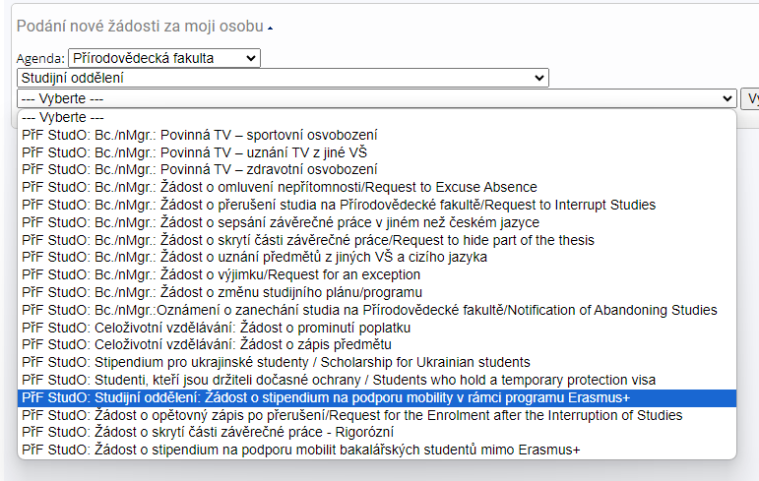
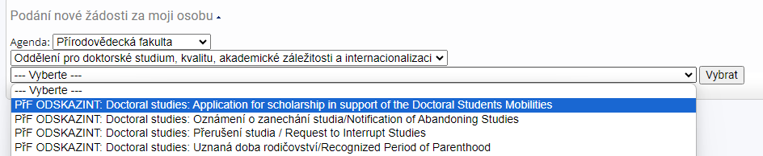



Faculty mobility scholarships - applications in the Document Office IS MU
For Bc. Students
A.5a -> Erasmus+ support
A.5.b -> support for stays outside mobility programmes
For Mgr. Students
A.5a -> Erasmus+ support
For PhD students
A.6 -> support for stays of more than 30 days (shorter stays only if the mandatory internship is split)
A.5 applications needs to be submitted within 1 month after starting the mobility!!!
Dean‘s Measure 7/2019 – Terms of Scholarships programmes

Slide 18
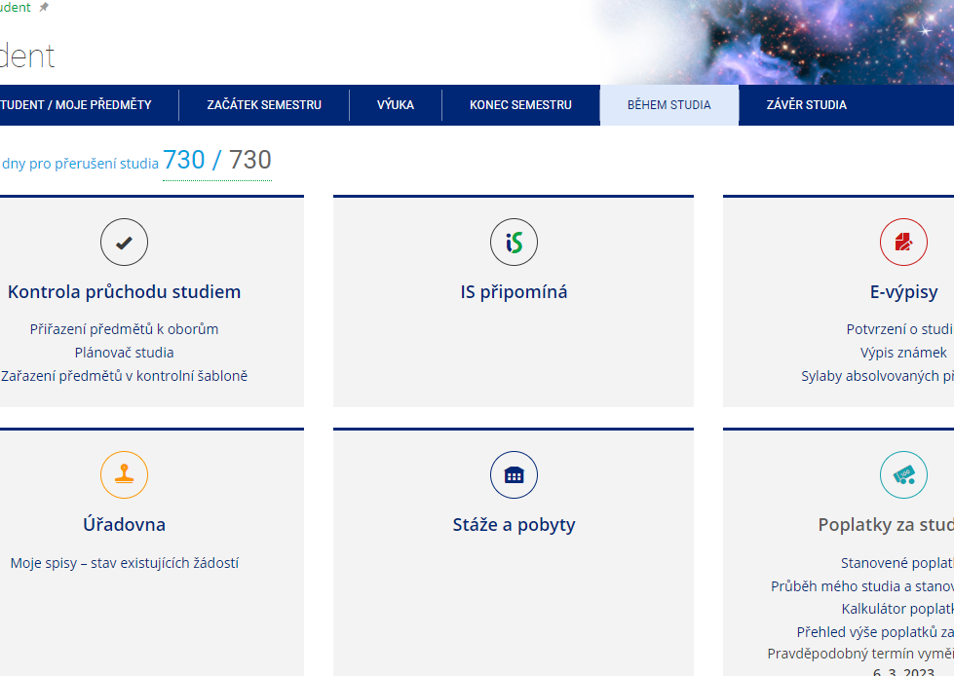
RECORD OF YOUR STAY IN IS MU
MANDATORY RECORD OF STAY!
Any stay abroad as part of your studies at MU is considered a study or work stay. In both cases, the internship or placement must be part of the study and, therefore, recognised as part of the MU studies.
Information and procedures here

Slide 19
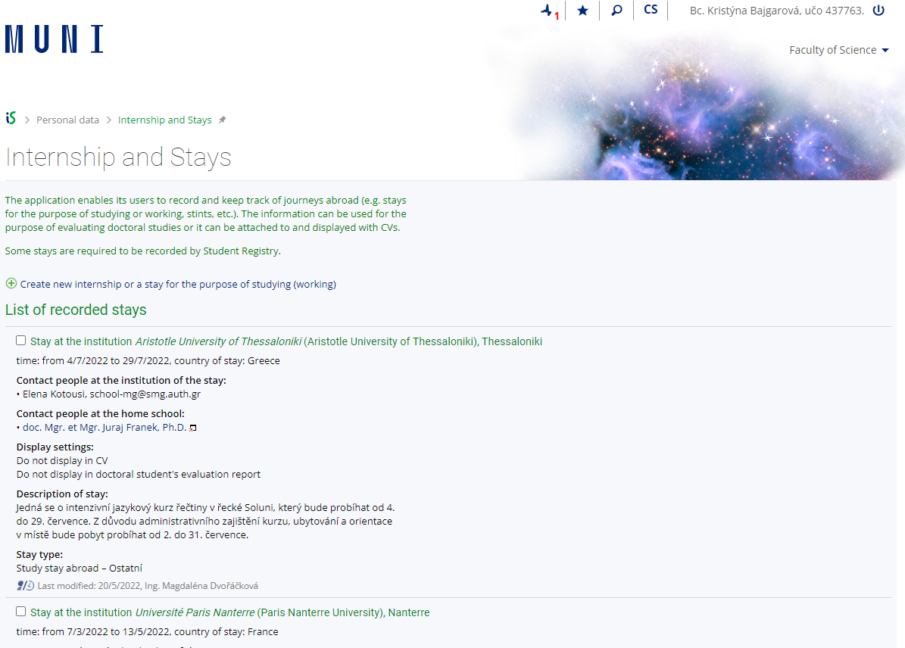
Recognition of your stay
Any stay abroad is considered a study or work stay. In both cases, the internship or placement must be part of the study and, therefore, recognised as part of the MU studies.
Recognition takes place AFTER arrival! Do NOT register any course that you want to have recognized in advance!
You will discuss with your subject coordinator and your teachers what foreign courses can be recognised.
Request for recognition -> in the Record of your stay, after uploading the documents
For study stays -> Learning agreement + Confirmation of Studies + Transcript of Records
For placements -> Learning agreement for Traineeships + Traineeship Certificate
The application is processed by the Study Department - your Study assistant can help if you have any problems with the application
Step-by-Step instructions are on the SCI MUNI website (as well as on the CZS website)

Slide 20

What to watch out for
Don't be afraid to ask for information! At our faculty, at CZS... we are here for you.
Think about what is the best option for you - where do you want to go? What is your main goal (to go abroad, to try it out... anywhere? Or to focus on a specific institution already, because it's beneficial for your thesis, for example? For how long?)
Read the requirements of the programme well – deadlines, mandatory documents…
Close the application form in ISOIS by the deadline and submit all documents
Make sure you have a good cover letter - feel free to come to us for advice.
A transcript of grades can be generated in the MU IS, as well as a certificate of study (also available in ENG ;-))

Slide 21

How to write a cover letter
The Motivation Letter has to contain
Addressee (who you are writing to), signed by the student
request for financial support from the Erasmus+ programme
the field of study, level and the year in which the applicant is registered
the reason for the host institution selection
what the content of the traineeship will be and why
direct relation to the student's field of study
benefits of the traineeship for the student – academic benefits, job opportunity benefits
benefits for Masaryk University
benefits for the host institution
the period of the traineeship for which the student is asking for the financial support
in the case of selection of agencies and public institutions from the student's country of origin, i.e. cultural institution, Czech centres, region/school representation, etc., it is necessary to justify the selection of the institution considering the internationality of the traineeship
The motivation letter is to be written in Czech, Slovak or English.
The maximum length of the motivation letter is one A4 page.
Use AI wisely - never let it write the whole cover letter for you!!!
Beware of overly general formulations! ->
Try to personalize it, why they should send YOU there?

Slide 22
The closest deadlines
30.10.2025 – DAAD Summer Language courses
31.10.2025
– EDUC Miniprojects – realization anytime until the end of 2026
– EDUC Gap Year – for Spring semester 2026
– Erasmus+ SMP INTERNSHIPS for Spring 2026
– Erasmus+ INTERNSHIPS OUTSIDE EUROPE for Spring 2026
NOVEMBER 2025 – faculty quota for Partner Universities 2026/2027 (exact deadline TBA)
October/February – A*STAR Agency for Science, Technology and Research Singapore
1.11.2025 CEEPUS freemover for Spring 2026
17.11.2025 DAAD 1-year study stay for Master students
1.12.2025 – BTHA 1-year study stays for Master students
15.12.2025
– Freemover for calendar year 2026 – study stays, internships
– mobility programmes outside Europe – ISEP, Partner universities (university-wide applications), Erasmus ICM+,… for academic year 2026/2027
16.1.2026 – Georgia study stays or summer language/cultural courses
31.1.2026 – Vietnam study stays
1.2.2026 – Fulbright Visiting student researcher (only Master or PhD students)
FEBRUARY 2026 – Erasmus+ SMS STUDY STAYS for academic year 2026/2027

Slide 23
DEPARTMENT COORDINATORS
Department of Experimental Biology– Pavel Hyršl (hyrsl@sci.muni.cz)
Department of Botany and Zoology – Soňa Hroudová (hroudova@sci.muni.cz)
Department of Anthropology – Martin Čuta (cuta@sci.muni.cz)
Department of Chemistry– Pavel Brož (broz@chemi.muni.cz)
Department of Biochemistry– Jan Lochman (lochik@mail.muni.cz)
RECETOX – Tereza Nováková (tereza.novakova@recetox.muni.cz)
NCBR – Veronika Papoušková (papouskova@ncbr.muni.cz) (
Department of Mathematics and Statistics – Josef Šilhan (silhan@math.muni.cz)
Department of Geological Sciences – Adam Říčka (ricka@sci.muni.cz)
Department of Geography – Jarmila Burianová (burianova@geogr.muni.cz)
Department of Condensed Matter Physics– Karel Kubíček (karelk@mail.muni.cz)
Department of Plasma Physics and Technology – Zdeněk Bonaventura (zbona@physics.muni.cz)
Department of Theoretical Physics and Astrophysics – Jan Janík (honza@physics.muni.cz)

Slide 24



WHERE CAN I FIND INFORMATION?
Faculty website
CZS
Do světa
Department Coordinators
Academic Information Agency
International Relations Office
Instagram

Slide 25


What was the biggest benefit?
Language contribution
Food
Culture
New friends
Travel, new places
Knowledge enhancement, educational aspect
Experience outside your comfort zone
Independence
Overcoming obstacles
Learning to be alone for extended periods of time without friends and family from home

Slide 26

What was the hardest before/after?
Unpacking the suitcase
Return
Time delay
Temperature difference
Think like a local Paperwork
Choose the right courses
Adapting to another country's new daily routine

Slide 27
CONTACTS
Office for Doctoral Studies, Quality, Academic Affairs and Internationalization A: Kotlářská 2, building 1, room 01006
Common email: int@sci.muni.cz
Kristýna Bajgarová: bajgarova@sci.muni.cz 549 49 5051

